Slide 1
Annual Committee Meeting 2
Zenabu Suboi
9th June, 2026

Slide 2
Agenda
Topic: Uncertainty Quantification of Agent-based Models with Application to Malaria Intervention Modeling
Summary from last year
Time plan
Progress update
Objective 1 (Evaluating community protection)
Next steps

Slide 3
Summary from last year’s meeting
ACTIVITY | DATE
2024
COURSES (10 ECTS) | FEBRUARY – JUNE
OPENMALARIA TRAINING | MAY – JULY
PROPOSAL WRITING, PRESENTATION AND SUBMISSION | FEBRUARY – AUGUST
MATHEMATICAL MODELING WORKSHOP (CAPE COAST, GHANA) | OCTOBER
2025
COURSES (4 ECTS) | FEBRUARY – JUNE
ASTMH ABSTRACT SUBMISSION | APRIL
MANUSCRIPT (SENSITIVITY ANALYSIS) | FEBRUARY – ONGOING
OBJECTIVE 1 (SENSITIVITY ANALYSIS) | SEPTEMBER (2024) – ONGOING
NEW DIRECTION FOR OBJECTIVE 1 (Community protection)

Slide 4
Time plan: Feb 2024 – Sep 2027
Obj. | Main Activity | 2024 |  |  |  | 2025 |  |  |  | 2026 |  |  |  | 2027
 |  | Q1 | Q2 | Q3 | Q4 | Q1 | Q2 | Q3 | Q4 | Q1 | Q2 | Q3 | Q4 | Q1 | Q2 | Q3
 | Proposal writing and submission
1 | OpenMalaria training
 | Sensitivity analysis and parameter identification
 | Community protection
 | Paper 1
2 | Understanding the drivers of malaria intervention prioritization
 | Paper 2
3 | Calibration of Openmalaria using emulators
 | Paper 3
 | Thesis writing
Notes:
Fraction of the original burden removed

Slide 5
Progress update (July 2025 - June 2026)
Jul.
Aug.
Sep.
Oct.
Nov.
Dec.
Jan.
Feb.
Mar.
Apr.
May.
Jun.
Evaluating the community effects of LLINs across transmission intensities
Cohort implementation in OM
Simulation setup and running
Analysis of simulation outputs
Updated simulation with new LLIN parameterization
Summer school, Kenya
Refinements, final simulation runs and analysing outputs
Manuscript writing
Final Course work
Presentation of results to CHAI

Slide 6
Evaluating the Community Effects of LLINs Across Transmission Intensities

Slide 7
Introduction

Slide 8
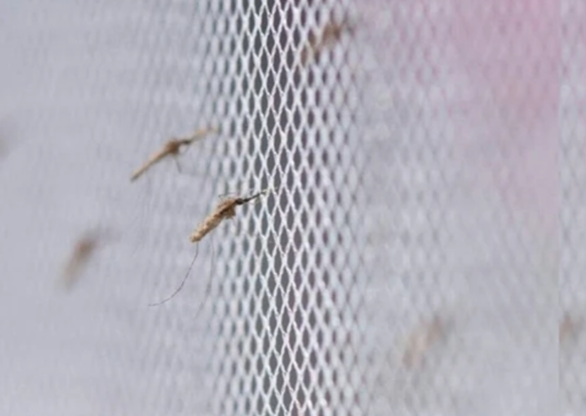
LLIN effectiveness
Long lasting insecticidal nets (LLINs) have been attributed with averting 663 million clinical cases from 2000 – 2015
effectiveness of LLINs arises from two complementary mechanisms:
physical prevention of mosquito bites
insecticidal action that kills or deters mosquitoes
Protecting both users and non-users
Source: https://link.springer.com/article/10.1186/s12936-020-03321-6

Slide 9
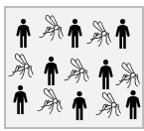
The concept of community protection
LLINs offer different benefits for users and non-users within a population
No LLIN use

Slide 10
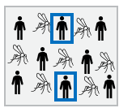
The concept of community protection
LLINs offer different benefits for users and non-users within a population
net-users receive personal protection
No LLIN use
X% LLIN use

Slide 11
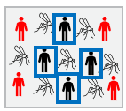
The concept of community protection
LLINs offer different benefits for users and non-users within a population
net-users receive personal protection
both users and non-users benefit from reduced transmission
reduced mosquito density, lifespan, and proportion of infectious mosquitoes
This concept has been established as community (indirect) protection
No LLIN use
X% LLIN use
Increased LLIN use
Source: Adapted from Unwin et. al ,2023

Slide 12
Evidence of community protection
Evidence from both empirical (Hawley et al., 2003 , Lukole et al., 2025) and modelling studies (Killeen et al., 2007, Unwin et al., 2023)
These evidences indicate that
vary by spatial scale and local coverage levels (Hawley et al., 2003)
depends on proximity with treated net users (Hawley et al., 2003)
heterogeneous and sensitive to local transmission dynamics, intervention coverage, and vector ecology (Killeen et al. 2007, Unwin et al, 2023)
present in settings with pyrethroid resistance depending on net type (Lukole, et al., 2025, Unwin et al, 2023)
Notes:
In western kenya –
Modeling evidence – CL
Unwin et al
Multi-country DHS analysis

Slide 13
What this study focuses on
the magnitude and robustness of community protection remain incompletely evaluated across epidemiological settings
we use OpenMalaria to evaluate the effects of LLIN usage on LLIN users and non-users across a wide range of transmission intensities and effective usage levels.

Slide 14
Methods

Slide 15
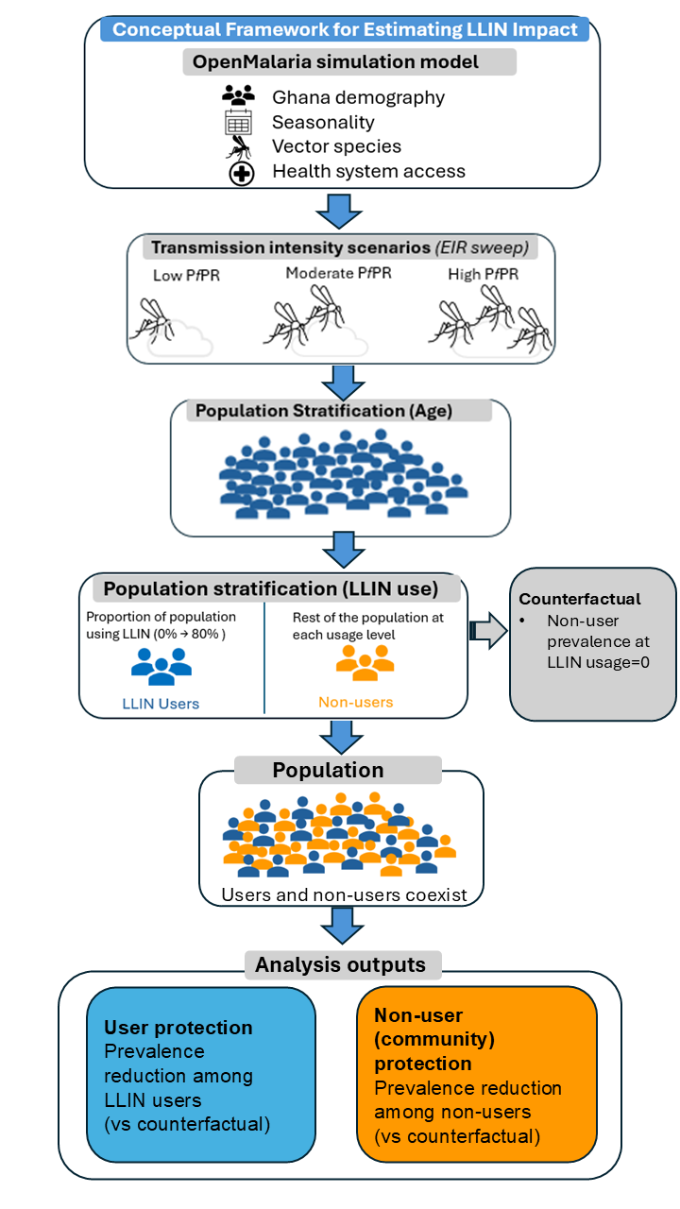
Methods
Ghana context

Slide 16
Methods
EIR: 1-100
Low PfPR: [≤ 10%]
Moderate PfPR : [13-34%]
High PfPR : [36-46%]

Slide 17
Methods
EIR: 1-100
Low PfPR: [≤ 10%]
Moderate PfPR : [13-34%]
High PfPR : [36-46%]
Simulated pop size: 50’000
Age groups: 0-100

Slide 18
Methods
EIR: 1-100
Low PfPR: [≤ 10%]
Moderate PfPR : [13-34%]
High PfPR : [36-46%]
Simulated pop size: 50’000
Age groups: 0-100
Net Characteristics
Type - IG2
Half-life – 2.4
Effective usage: 0-80%
Efficacy based on CIV EHT – (Assenga et al., 2025)

Slide 19
Methods
EIR: 1-100
Low PfPR: [≤ 10%]
Moderate PfPR : [13-34%]
High PfPR : [36-46%]
Simulated pop size: 50’000
Age groups: 0-100
Net Characteristics
Type - IG2
Half-life – 2.4
Effective usage: 0-80%
Efficacy based on CIV EHT – (Assenga et al., 2025)
Intervention Years
Effective Treatment: 2000-2031
IG2 net: 2023, 2026, 2029

Slide 20
Methods
EIR: 1-100
Low PfPR: [≤ 10%]
Moderate PfPR : [13-34%]
High PfPR : [36-46%]
Simulated pop size: 50’000
Age groups: 0-100
Net Characteristics
Type - IG2
Half-life – 2.4
Effective usage: 0-80%
Efficacy based on CIV EHT – (Assenga et al., 2025)
Intervention Years
Effective Treatment: 2000-2031
IG2 net: 2023, 2026, 2029

Slide 21
Results

Slide 22
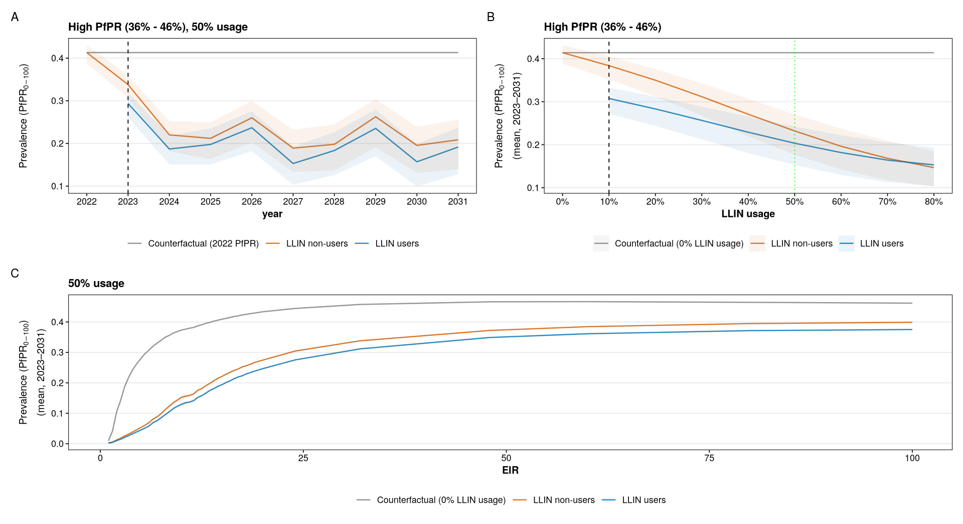
Prevalence in non-users varies with usage and transmission intensity but not with time
Notes:
Prevalence in both populations followed similar trends across time, usage and EIR with prevalence among users being consistently lower. Prevalence among non-users varied with usage and EIR but not with time

Slide 23
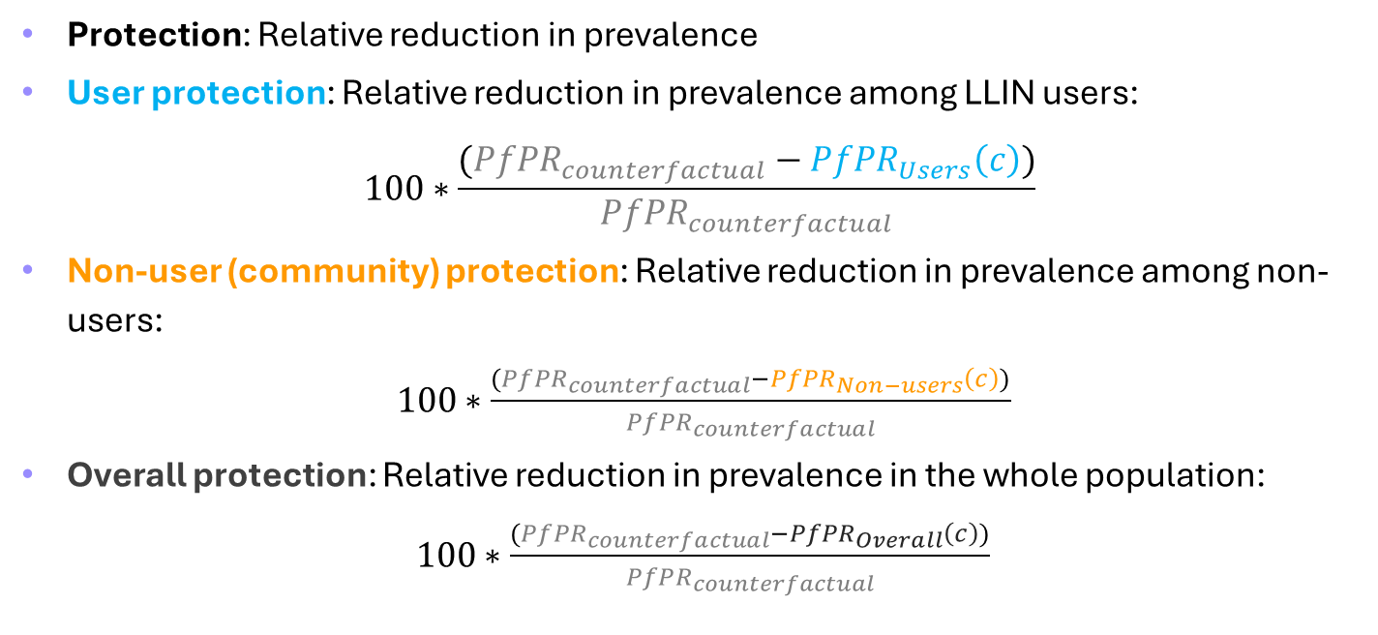
Impact definitions and estimates: User and Non-user (community) protection
Protection: Relative reduction in prevalence
User protection: Relative reduction in prevalence among LLIN users:
$$100∗\frac{({PfPR}_{counterfactual}−{PfPR}_{Users}\left(c\right))}{{PfPR}_{counterfactual}}$$
Non-user (community) protection: Relative reduction in prevalence among non-users:
$100∗\frac{({PfPR}_{counterfactual}−{PfPR}_{Non−users}\left(c\right))}{{PfPR}_{counterfactual}}$
Overall protection: Relative reduction in prevalence in the whole population:
$100∗\frac{({PfPR}_{counterfactual}−{PfPR}_{Overall}\left(c\right))}{{PfPR}_{counterfactual}}$
c =effective usage
Notes:
Figure 2 – what fraction of the original burden has been removed in both sub-populations across transmission intensities? – is there a plateau?
Overall protection: Relative reduction in prevalence among the overall population: $100∗\frac{({PfPR}_{x,baseline}−{PfPR}_{x,Population}\left(c\right))}{{PfPR}_{x,baseline}}$

Slide 24
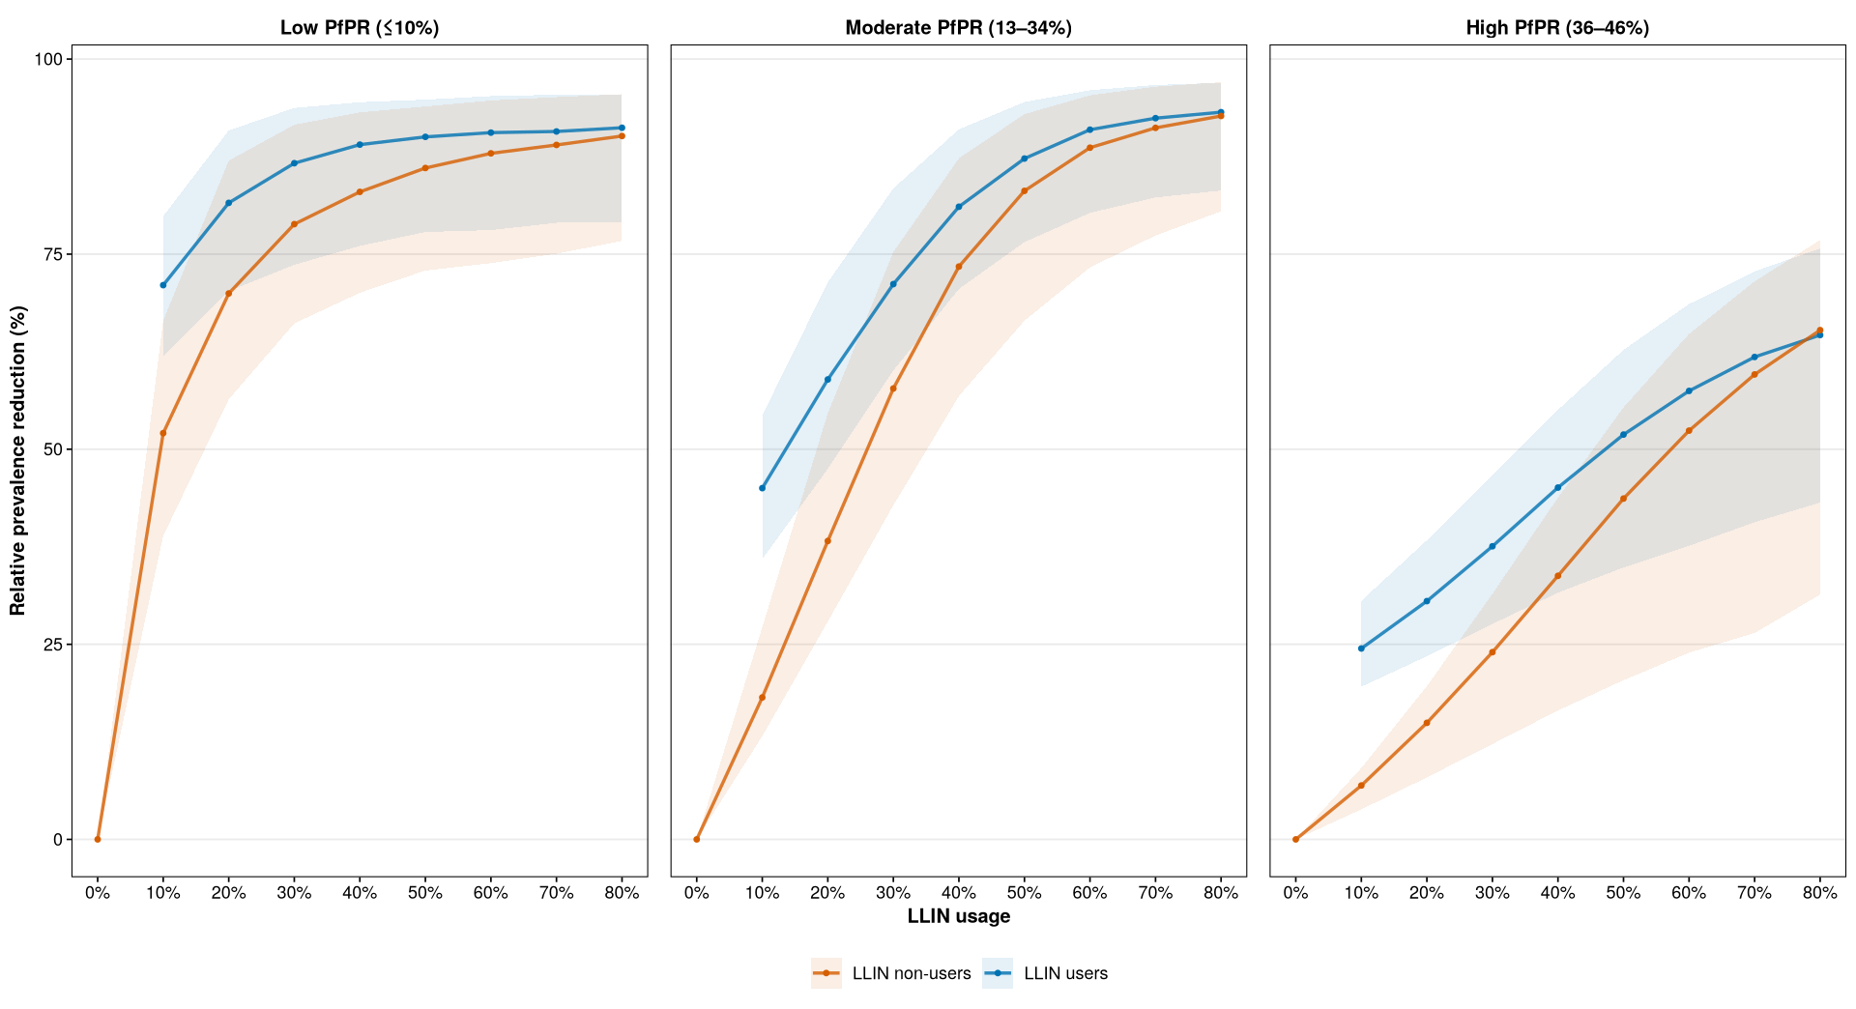
community protection plateaus with usage in low and moderate but not in high transmission setting
Notes:
Fraction of the original burden removed

Slide 25
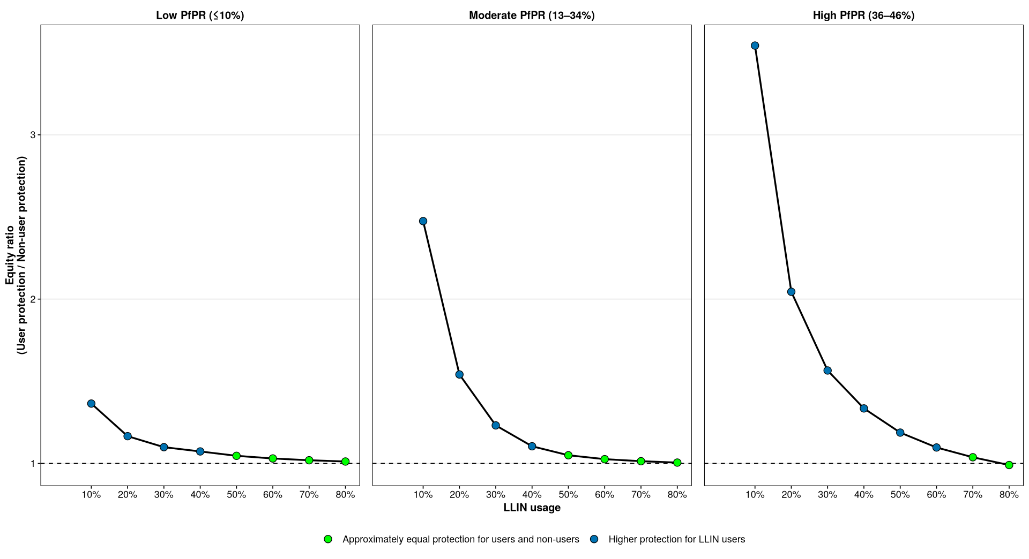
Users and non-user achieve nearly equitable benefits ~50% usage in low and moderate but much higher (~70%) in high PfPR setting
Notes:
Relative protection ratio

Slide 26
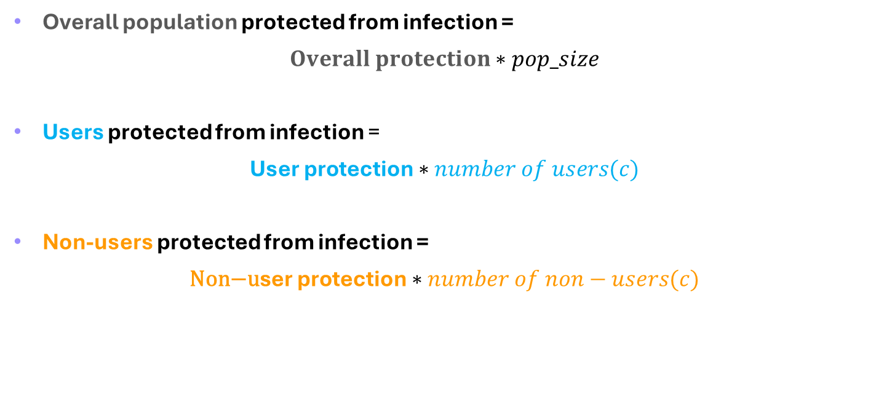
Impact definitions and estimates: Users and Non-users protected from infection
Overall population protected from infection =
$Overall protection∗pop_size$
Users protected from infection =
$\text{User} \text{protection}∗number of users(c)$
Non-users protected from infection =
$\text{N}\text{on}\text{−}\text{u}\text{ser} \text{protection}∗number of non−users(c)$
c =effective usage
Notes:
Figures 3, 4, 5 – For any given number of users protected with nets, how many users and non-users were actually protected from infection?
- When does community protection compensate for low or moderate coverage?

Slide 27
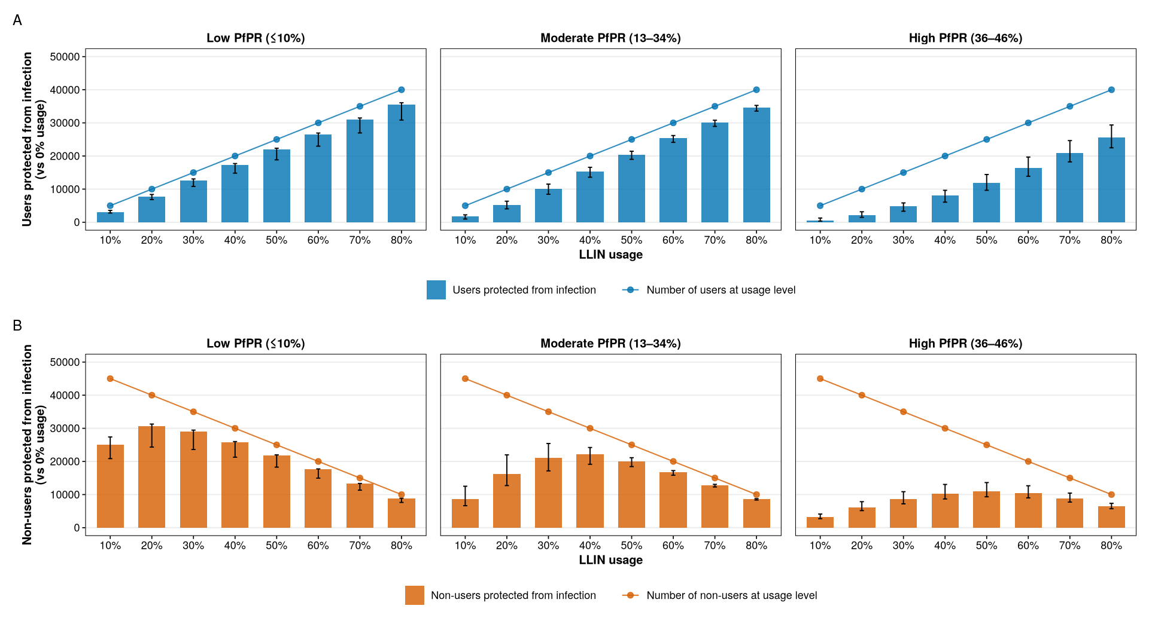
Usage level at which non-users benefit maximally shifts toward high levels with increasing PfPR (20 40 50%)
Notes:
This indicate that more resources are required to achieve comparable non-user benefits with increasing transmission intensity
Usage level at which non-users benefit maximally shifts toward high levels with increasing PfPR

Slide 28
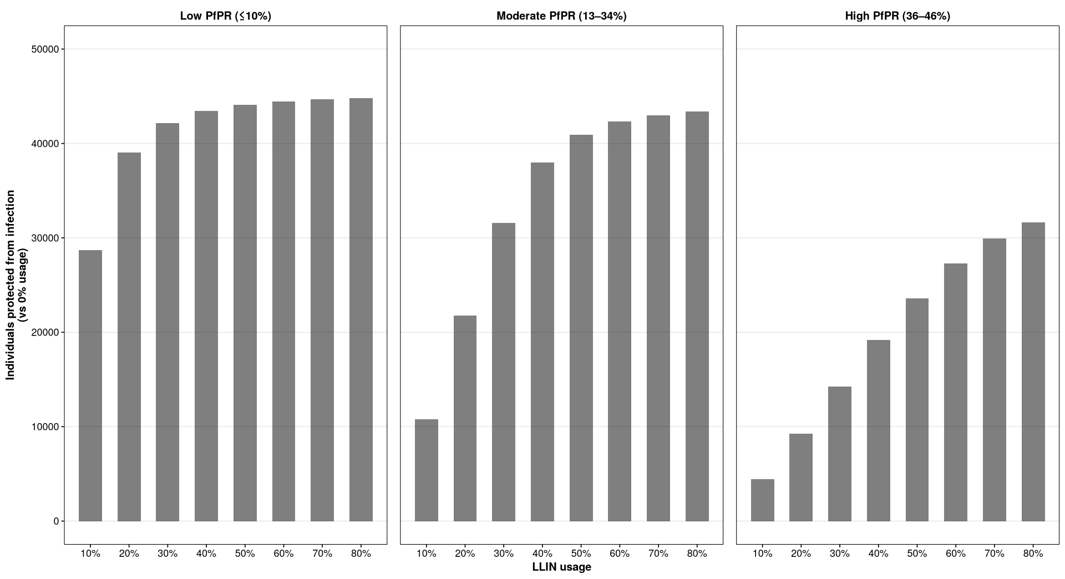
Individuals protected from infection declines with increasing PfPR

Slide 29
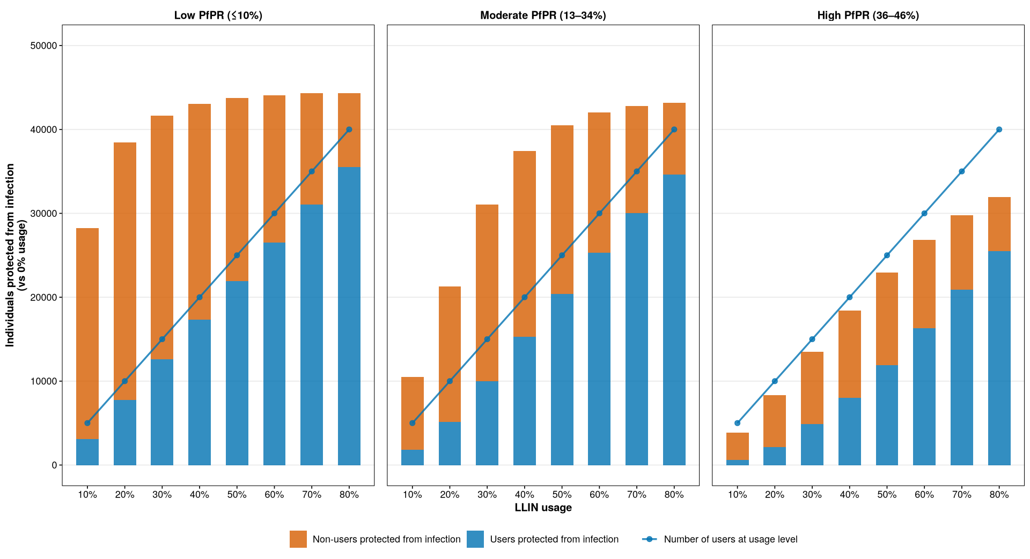
community protection compensates for moderate coverage in low (40%) and moderate (60%) transmission

Slide 30
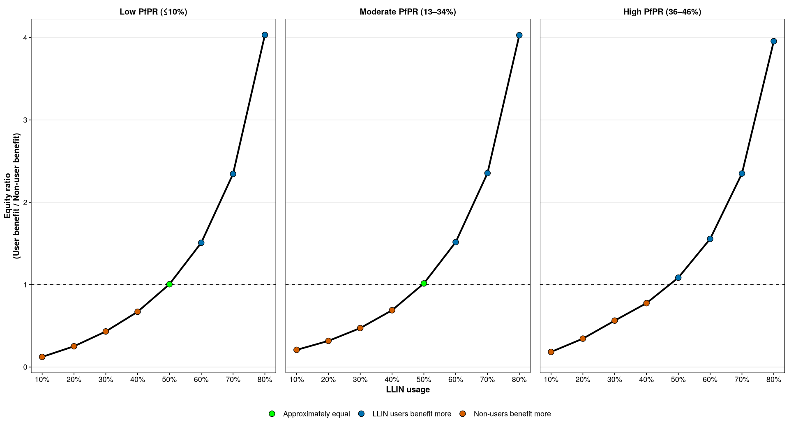
both users and non-users benefit similarly at ~50% usage in all transmission settings

Slide 31
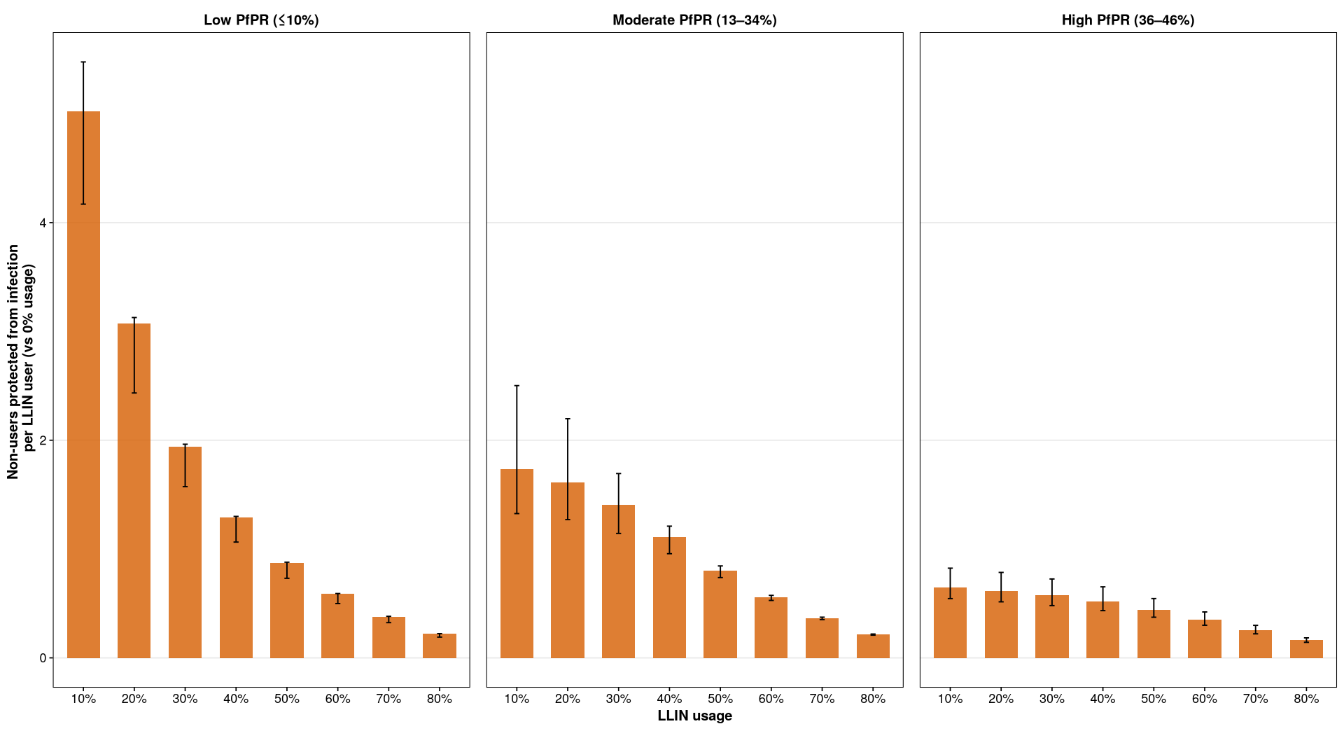
Non-users protected from infection per LLIN user decreases with increasing usage across transmission intensities

Slide 32
Key messages
Community protection varies with usage and transmission intensity, but not with time
Community protection and individuals protected from infection plateaus in low (40%) and moderate (60%) but not in high transmission intensity
Community protection compensates for moderate (~40% - 60%) usage in low and moderate transmission intensities
Notes:
There is equitable community-wide benefit at ~50% usage in low and moderate PfPR, but at a much higher usage in high PfPR

Slide 33
Key messages
Community protection contributes to the overall protection from infection, and the highest non-user benefits are achieved early (~ ≤ 50% usage)
Non-users protected from infection per LLIN user decreases with increasing usage across all transmission intensities
Notes:
Consistent and effective use of nets is required to preserve community protection and strategies to increase usage should be deployed

Slide 34

Comparison with literature
Moderate to high transmission setting - Tanzania
Chlorphenapyr arm (IG2) provides protection among non-users with cluster usage below 40% (Lukole et al., 2025)
high transmission setting – Western Kenya
at least 35% community coverage of nets is required to protect non-users (Osuke et al., 2012)
modeling
Modest coverage 35–65% can achieve community-wide benefits (Killeen et al., 2007)
one LLIN user provides some protection to non-users (Unwin et al., 2023)
Notes:
Fraction of the original burden removed

Slide 35
Recommendations:
low to moderate effective usage ~(30% - 50%) is recommended in low transmission
moderate effective usage (~50% - 60%) is recommended in moderate transmission
In high transmission, high effective usage is recommended as gains continue to increase with increasing coverage (no plateau)

Slide 36
Recommendations:
LLINs should be complimented with other malaria control interventions, especially in high transmission

Slide 37
Limitations
The model simplifies reality, and may not fully capture all sources of heterogeneity present in real-world contexts, including:
variations in human behaviour
Activity patterns of vectors
durability of nets
intervention adherence
spatial heterogeneity
We assume that users and non-users are in close enough proximity
The effect of the spread of pyrethroid resistance was not considered here which could alter the LLIN effects estimated
Notes:
Fraction of the original burden removed

Slide 38
Conclusion
LLIN scale-up is context dependent in a sense that while high coverage is recommended in high transmission settings, high coverage in low transmission is not efficient due to community protection
Notes:
Fraction of the original burden removed

Slide 39
Moving Forward
ACTIVITY | DATE
2026
COMPLETE MANUSCRIPT FOR OBJECTIVE 1 AND SUBMIT | AUGUST
START WITH OBJECTIVE 2 | SEPTEMBER
Notes:
Fraction of the original burden removed

Slide 40
Thank you for your attention

